Slide 1
Biostimulant Certifcation Program
TFI InfoAg
Conference
Ed Thomas
Vice-President, Government Affairs
June 27, 2023
Notes:
ET

Slide 2
What is it?
The "Certified Biostimulant" program was developed by industry and is an industry-driven program:
Voluntary
Intended to demonstrate that a product meets recognized conformance standards for efficacy, safety, and composition
Does not certify product efficacy
Certifies that efficacy research testing methods have been conducted in accordance with the conformance standards

Slide 3
Industry Benefits of Certification
Manufacturers demonstrate conformance with fair and equitable voluntary standards to demonstrate products meet efficacy research testing methods, composition, and safety attributes;
Streamlines state regulatory review process which will improve efficiencies for the path to market and decrease time for final market/registration approval;
Enables ag retailers to assess products more confidently for shelf space, assists in the selection of products for investing in further independent field trials, and ultimately grower recommendation;
Provides a single uniform application for use by all 50 state registration programs (several states may require additional information that will be included in later updates to the web portal, as appropriate);
Provides retail and grower confidence in product compliance with an industry program seal (e.g. Adjuvant Certification, etc.)

Slide 4
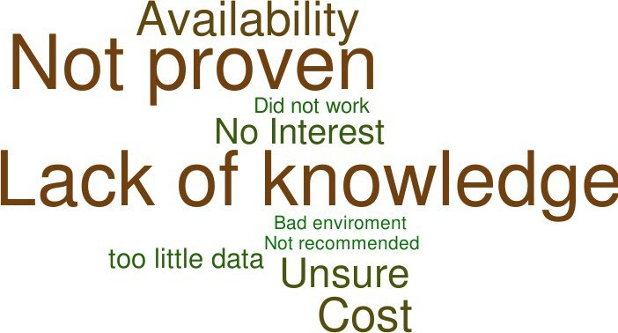
Producers who have never used biologicals believe they are not proven, or have a lack of knowledge on the subject
Grower Benefits of Certification
(ONLY if answered NO in Used Biological in the Past) Why have you chosen not to use any of these product types? N=270

Slide 5
Certification Program Timeline
Jan 2019 –Industry kick off of BMP’s
Nov 2021 - Present- TFI Certification Task Force Launched; Meets 18 times
Mar 2022 – Present: 7 full TFI member briefings and regular industry briefings
Nov 2022 – Full Program Reviewed by TFI Biostimulant Council
June 2023 – Biostimulant Certification Program Launched
July 2022 – Program publicly announced with Press Release and Intro. at InfoAg

Slide 6
Biostimulant Certification Task Force Roster
Name | Company | Class
Kuide Kin | Verdesian Life Sciences | Manufacturer
Eda Reinot | Indigo Ag | Manufacturer
Lyndon Smith | HUMA (BioHumaNetics) | Manufacturer
Chloe Tullock | New Leaf Symbiotic | Manufacturer
Carl Bruice | Wilbur-Ellis | Retailer
Doug Spaunhorst | MFA Incorporated | Retailer
Hugh Rodrigues | Thorton Laboratories | Laboratory
Upendra Singh | International Fertilizer Development Center | Laboratory/Trials
Mark LeBlanc (Advisor) | AAPFCO, Indiana | State Regulator
Notes:
ET

Slide 7
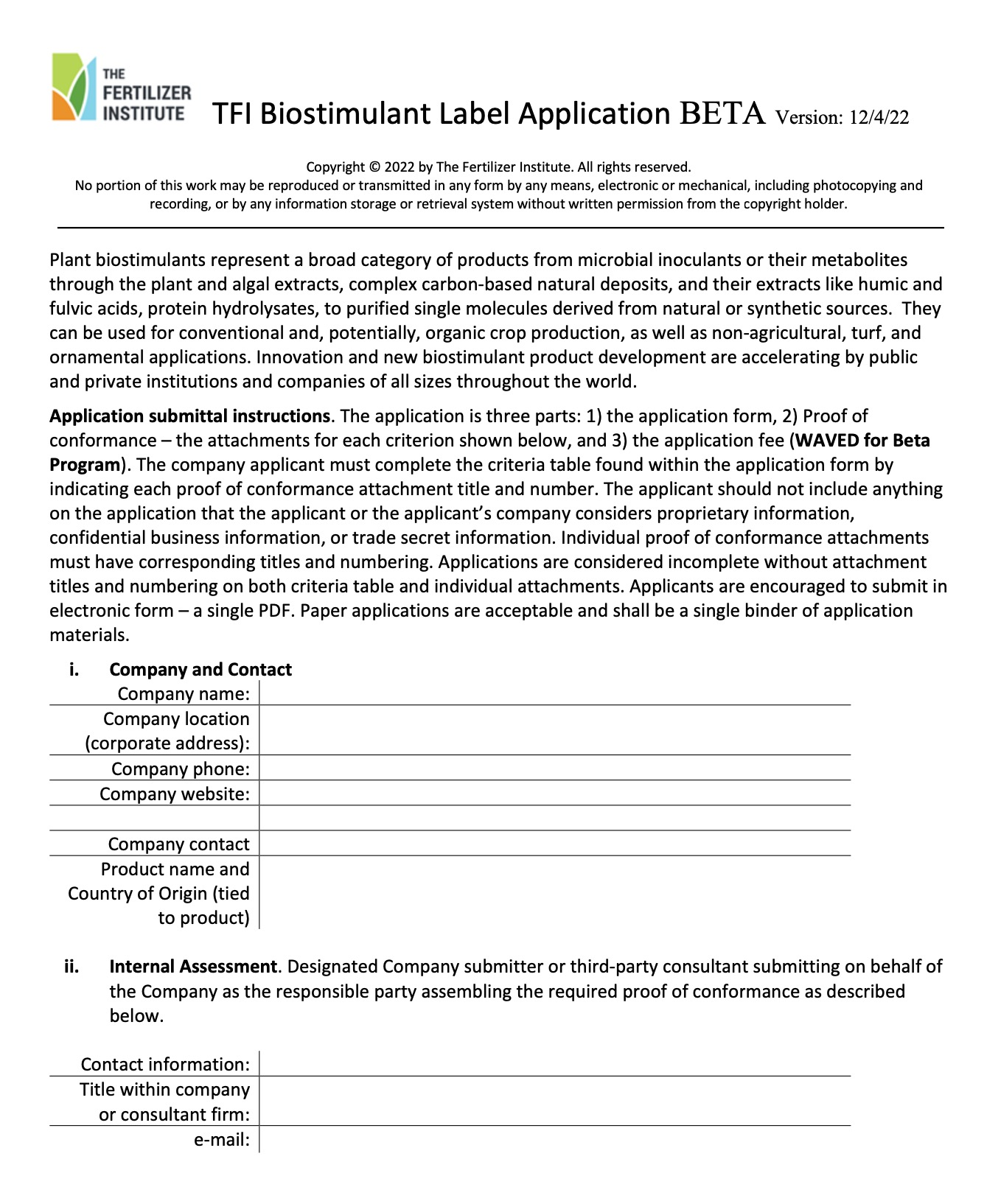
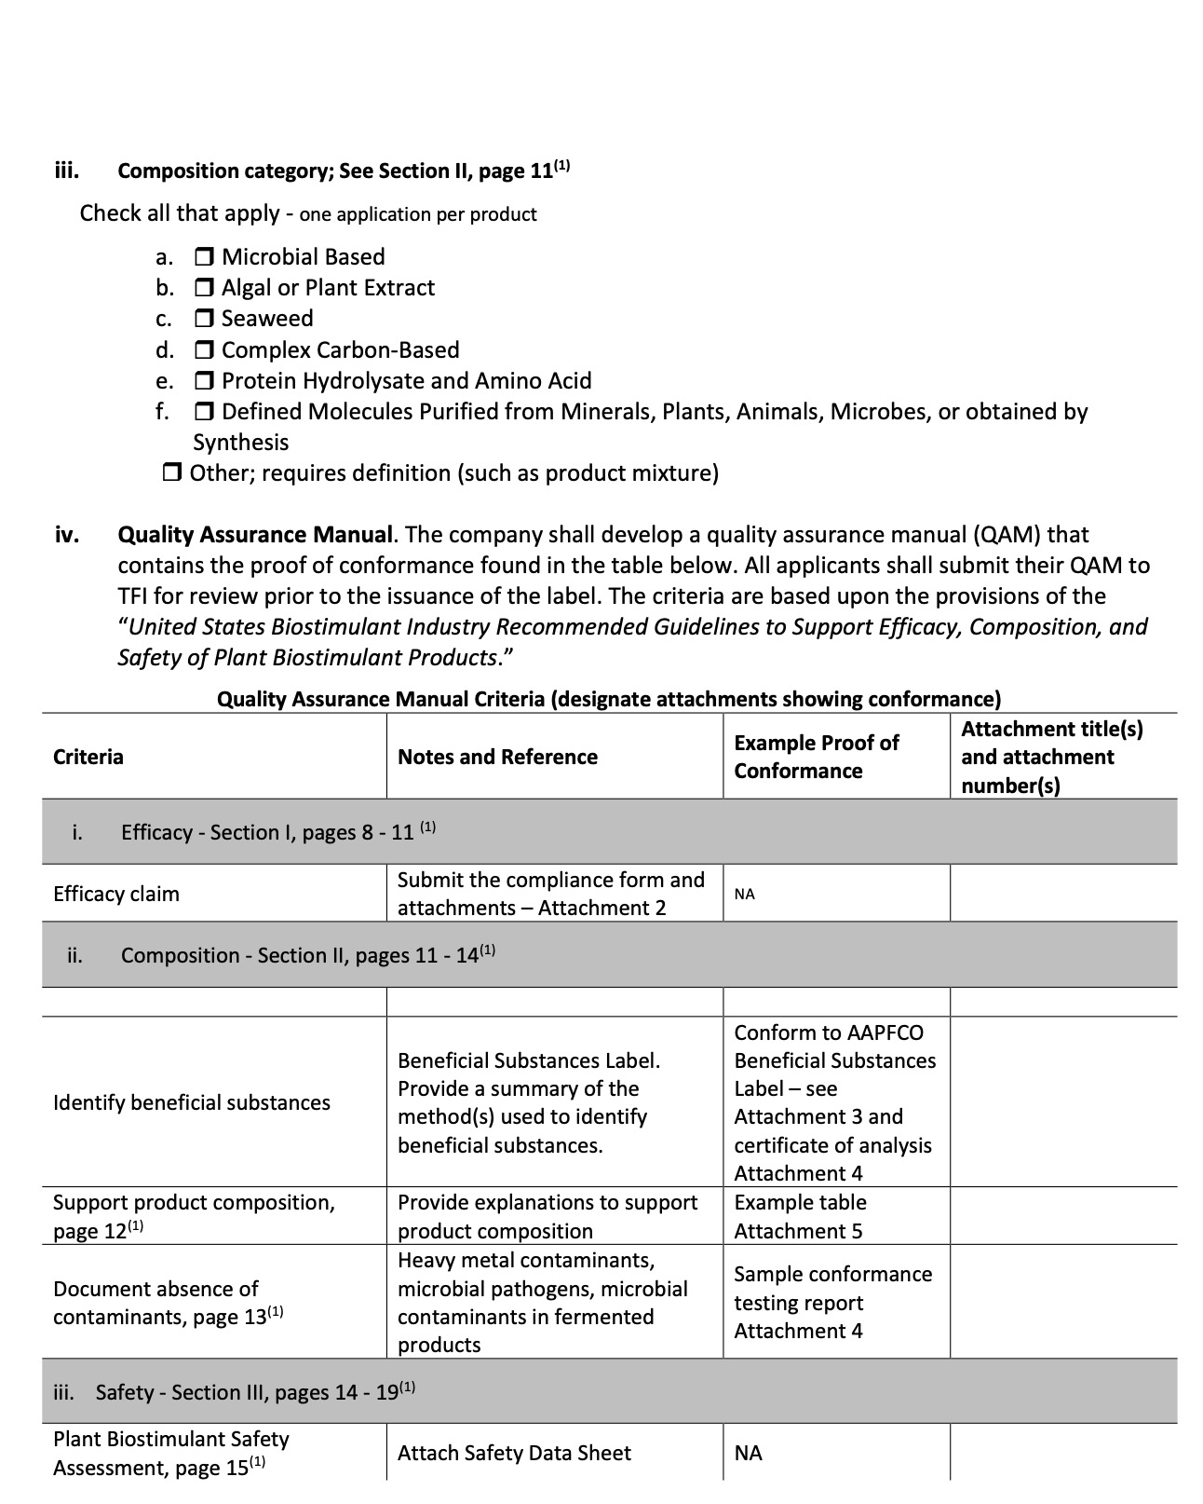
“Certified Biostimulant” Program Content:
Completed “Certified Biostimulant” Application
Program References and Attachments:
U.S. Biostim Guidelines for Efficacy, Composition and Safety
Efficacy Workbook
Product conformance lab testing
Guidelines to support product composition
Safety conformance guidance
Sample guidance statements of conformance
Label Examples
Attachment #1
Notes:
JHG;
Put in published journey article
Change #1

Slide 8
Our Solution to the “efficacy” issue
Remove subjectivity from issuing our certification label
Utilize the current recommendations to create a checklist approach
Developed by a body of industry scientists: United States Biostimulant Industry Recommendations to Assess the Efficacy, Composition, and Safety of Plant Biostimulant Products
Includes the key components for quality research and proper experimental set up
Leave the judgement & subjectivity of “efficacy” to state regulators
Regulators have the expertise in research methods

Slide 9
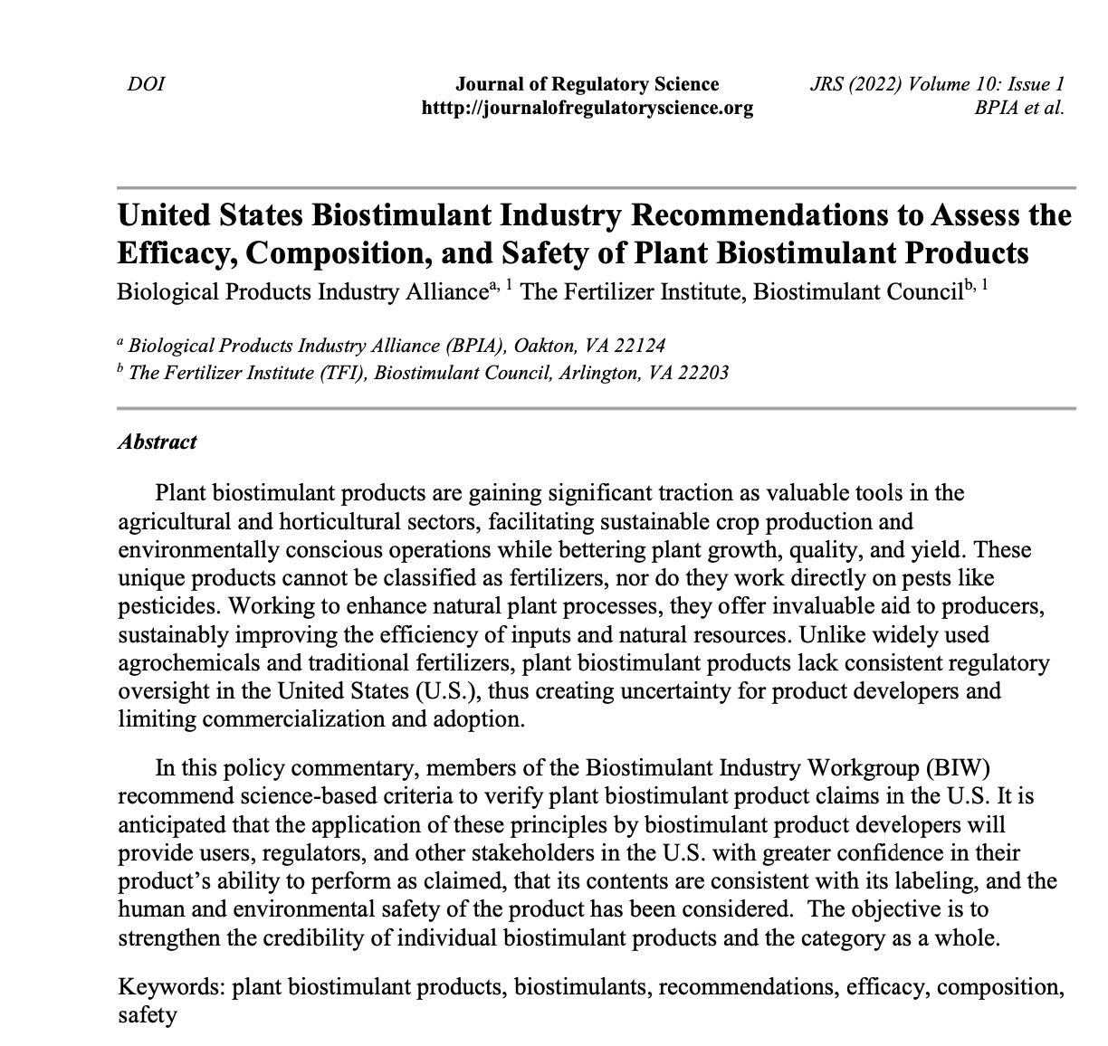
How the Efficacy Workbook was Designed
TFI designed the efficacy workbook from the
U.S. Biostimulant Industry Recommendations to Assess the Efficacy, Composition, and Safety of Plant Biostimulant Products

Slide 10
Efficacy Workbook
Option 1: Research Report
Option 2: Literature
Experimental Design
Trials and Locations
Climate, Soils, and Cropping System
Experimental Design,
Replications, number of observations,
Control treatments
Statistical methods (ANOVA, T-tests, etc.)
Statistical Analysis
Descriptive Statistics (i.e. mean, standard error)
Statistical Tests employed (i.e. ANOVA, HSD Tests)
Results
Explanation of results
Proper display of results in tables, figures, and text
OR

Slide 11
Commonly Asked Questions

Slide 12
What is the Certification Process?

Slide 13
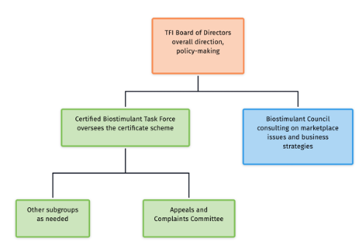
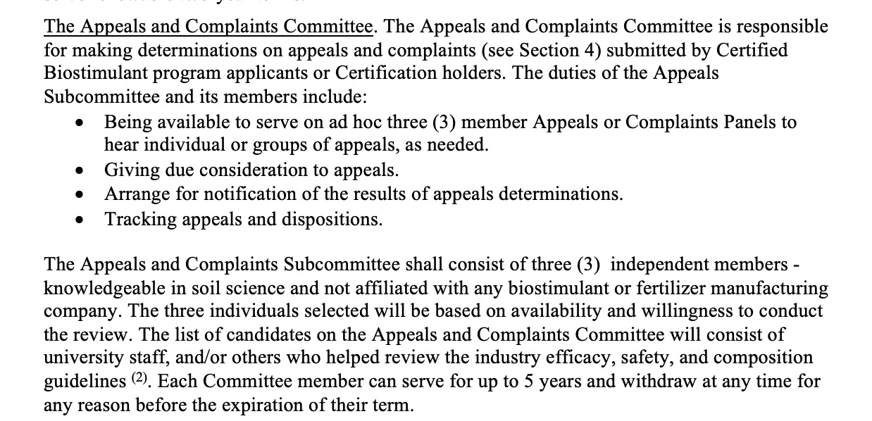
What is the Management and Appeals Process?

Slide 14
What Will be on the Certified Biostimulant Directory?
General Information
Company Name
Company Website
Product Name
Product Category (reference standard)
Sales contact name, email, & phone
Certification ID Number
Efficacy
Label Claim
Efficacy workbook (full version or CBI redacted)
Safety
Safety Data Sheet (SDS)
Composition
Manufacturer Product Label
Notes:
Efficacy – does not guarantee product performance, shows methodology of experimentation was conformant

Slide 15
What is the Cost?
 | Initial Review Fee | 2 Year Renewal Fee | Average Annual Cost (6 Years)
Certified Biostimulant Program | $1,800 | $750 | $550

Slide 16
Survey Background
A survey was created in January 2023 and distributed to the biostimulant industry
27 Participating Companies:
3Bar Biologics Acadian Plant Health ADM Advanced Nutrients Ag Infusion Intl. LLC AgroSpheres, Inc. AgXplore International, LLC American Infrastructure Holdings LLC Bioline Corporation Danstar Ferment AG EVOIA FBSciences Glogens Haifa North America He Indigo Ag Lebanon Seaboard Marco NPK NewLeaf Symbiotics Redox Bio-Nutrients, LLC Scotts Miracle-Gro Synsus Verdesian Wilbur-Ellis Company Yara

Slide 17
Survey Participants 27 participants
*Other either President/CEO/Executive
67% or respondents believe they will likely participate in the program

Slide 18
Thank You!
Ed Thomas ethomas@tfi.org
202-515-2714

